Slide 1

German Foreign Policy
1933 - 1939

Slide 2
Your Task
You are an expert in foreign policy
It is your job to advise the new leaders of Germany
You will be told about various problems and given a choice of three policies to follow.
Choose wisely. Your success will be rewarded. Failure will be punished!

Slide 3
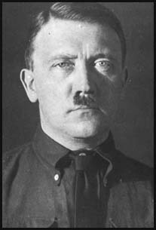
Mein Kampf
Your policy has very clear aims:
Destroy the Treaty of Versailles
Gain ‘Lebensraum’ (living space) in the east
Bring all Germans into one Reich
Make Germany strong again

Slide 4
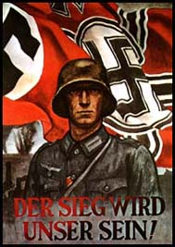
Crisis: Austria 1934
The Depression has made Austria weak
Taking over Austria will be very popular in Germany
It will bring many Germans into the Reich
However other countries might oppose you

Slide 5
Crisis: Austria 1934
Try to take over Austria by political pressure
Do nothing, its not worth annoying France, Britain and Italy
Try to take over Austria by sending troops to Vienna
A
B
C

Slide 6
Crisis: Austria 1934
20 Points
30 Points
10 Points
A
B
C

Slide 7
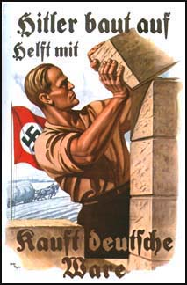
Crisis: Rhineland 1936
Italy has invaded Ethiopia
The League of Nations is divided
While the League is divided you could send troops to the Rhineland
Be careful! Any opposition and you’ll have to withdraw

Slide 8
Crisis: Rhineland 1936
Ask permission from the Allies before doing anything
Do nothing, you can’t risk war with France. Germany is too weak
Send in the troops. France is divided and Britain wants peace
A
B
C

Slide 9
Crisis: Rhineland 1936
30 Points
10 Points
20 Points
A
B
C

Slide 10
Crisis: Austria 1938
Austria is even weaker than in 1934
Italy is now your ally
You have many supporters in Austria, who can help you
Union with Austria is forbidden by the Treaty of Versailles

Slide 11
Crisis: Austria 1938
Try to take over Austria by political pressure
Do nothing, its not worth annoying France, Britain and Italy
Try to take over Austria by sending troops to Vienna
A
B
C

Slide 12
Crisis: Austria 1938
30 Points
20 Points
10 Points
A
B
C

Slide 13
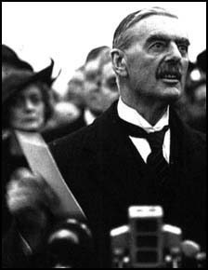
Crisis: Czechoslovakia 1938
Three million German speakers live in Czechoslovakia
Czechoslovakia has a strong army and alliances with Britain, France and the Soviet Union
Victory over the Czechs will finally destroy the Treaty of Versailles
The army is unwilling to fight over the Sudetenland

Slide 14
Crisis: Czechoslovakia 1938
Make a deal with Russia and hope Britain and France ignore your actions
Threaten the Czechs and make a deal with Britain and France
Invade Czechoslovakia and hope the army follows your orders
A
B
C

Slide 15
Crisis: Czechoslovakia 1938
10 Points
30 Points
20 Points
A
B
C

Slide 16
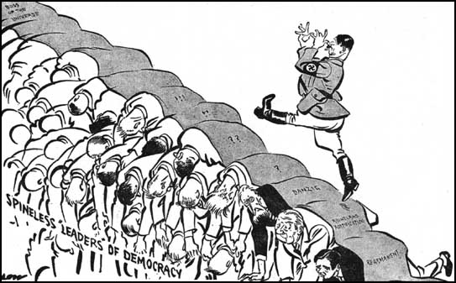
Crisis: Poland 1939
After victory over the Czechs you can’t do wrong
Poland splits German land and holds the German city of Danzig
Poland has an alliance with Britain and France
The Soviet Union could be a threat, the Red Army could easily help the Poles

Slide 17
Crisis: Poland 1939
Invade Poland without any agreements no-one can stop you now
Stop now, you’ve already achieved most of your aims
Do a Deal with Russia to split Poland between you
A
B
C

Slide 18
Crisis: Poland 1939
20 Points
10 Points
30 Points
A
B
C

Slide 19
Add up your scores

Slide 20
How did you do?
120 - 150 Points
Your advice has been superb for the outside world as war has been avoided
However, your advice has not been good for you. The Gestapo have arrested you and you are never seen again

Slide 21
How did you do?
90 – 110 Points
You’re not the expert the Nazi party thought you were. You’ve missed many opportunities to expand Germany’s population and resources
You have been demoted but you still have a comfortable life in Berlin

Slide 22
How did you do?
50 – 80 Points
Fantastic! you have made Germany strong again, the Treaty is a thing of the past and Germany is well prepared in case war comes.
You have been rewarded with promotion in the Nazi party and all the privileges of power

Slide 23
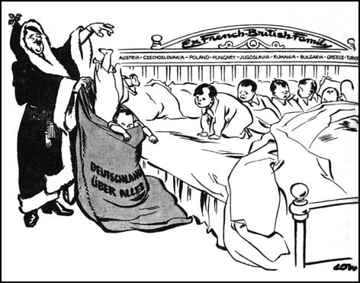
What did Hitler do?
Austria 1934
Rhineland 1936
Austria 1938
Czechoslovakia 1938
Poland 1939

Slide 24
What did Hitler do?
Crisis: Austria 1934
X
Do nothing, its not worth annoying France, Britain and Italy
Try to take over Austria by sending troops to Vienna
Try to take over Austria by political pressure
X
A
B
C

Slide 25
What did Hitler do?
Crisis: Rhineland 1936
X
X
Ask permission from the Allies before doing anything
Do nothing, you can’t risk war with France. Germany is too weak
Send in the troops. France is divided and Britain wants peace
A
B
C

Slide 26
What did Hitler do?
Crisis: Austria 1938
X
Try to take over Austria by political pressure
Do nothing, its not worth annoying France, Britain and Italy
Try to take over Austria by sending troops to Vienna
A
B
C

Slide 27
What did Hitler do?
Crisis: Czechoslovakia 1938
X
X
Threaten the Czechs and make a deal with Britain and France
Invade Czechoslovakia and hope the army follows your orders
Make a deal with Russia and hope Britain and France ignore your actions
A
B
C

Slide 28
What did Hitler do?
Crisis: Poland 1939
X
X
Invade Poland without any agreements no-one can stop you now
Stop now, you’ve already achieved most of your aims
Do a Deal with Russia to split Poland between you
A
B
C

Slide 29
Did Hitler follow a successful Foreign Policy?
Copy the above title onto file paper:
Answer the question as a piece of extended writing
Did Hitler achieve all his aims?
Did Hitler’s policies cause the war?
Did the war ultimately make Germany weak or strong?

